Slide 1
Sprint 2
Peter Liu, Russell Habib, Tony Cao

Slide 2
Introduction and Objectives
Peter Liu
  Refine code from Sprint 1, Create data ingestor for EAM data
Russell Habib
  Leanix/bluedoplhin connectors
  Mcp framework
Tony Cao
  Focused on developing and improving the quantum-readiness simulation engine to evaluate proposed infrastructure changes.
  Aimed to validate before-and-after simulation results and prepare the backend for frontend integration.

Slide 3
Feature implementation
MCP features: LeanIX/BlueDolphin connectors were added in sprint one and MCP connector framework was also done sprint one.
Data Ingestor: Takes EAM connector data and normalizes it for use in the Roadmap Generator.
Chat bot: Chat UI was done sprint one but will not be used as Team 1 has taken over the chat UI into their scope of the project.
Core Simulation Engine: Developed the simulation engine to evaluate quantum-readiness scenarios and assess the impact of proposed infrastructure changes.

Slide 4
Figma Prototype and Client Feedback
Our project is the backend of things, as team 1 for this project is front end we have nothing to share from our team for front end development

Slide 5
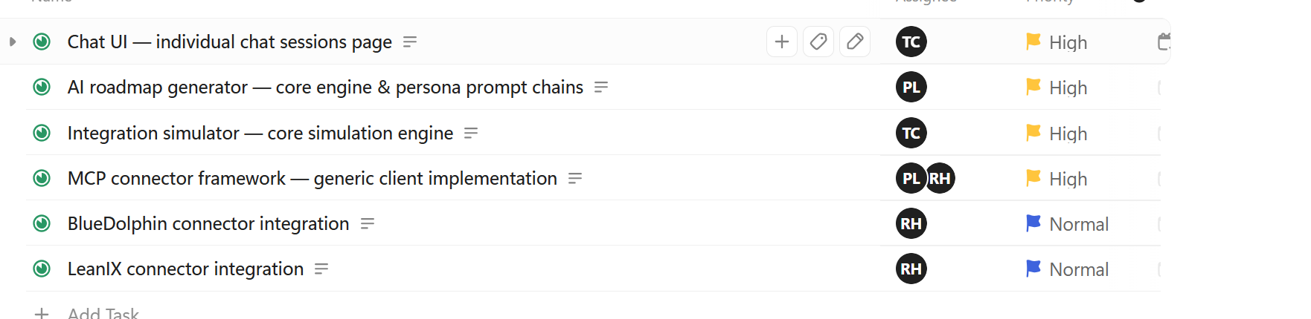
Kanban board/sprint objectives

Slide 6
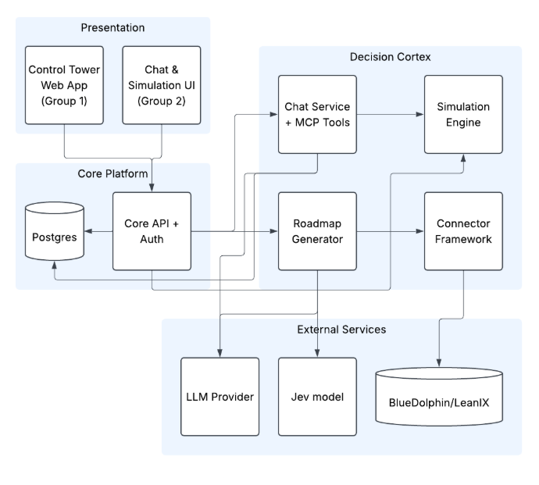
Documentation

Slide 7
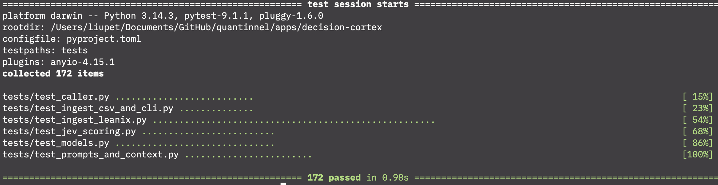
Documentation (Testing)
Unit test in pytest sample

Slide 8
AI use
Peter: Created framework for data ingestion + write tests
Russell: didn’t work much on code so used it for planning out next sprints objectives and do research to compare ci/cd tools for this project
Tony: help understand technical concepts and troubleshoot issues during simulation development.

Slide 9
Sprint achievements and challenges
Peter:
  Achievements: Was ahead of schedule from Sprint 1. Worked on normalizing data to fit the currently roadmap generation
  Challenges: Missing sample data from BlueDolphin and CSV imports, so those are currently stubs
Tony:
  Achievement: Developed the core simulation engine to evaluate quantum-readiness scenarios.
  Challenges: Encountered difficulties integrating simulation results with the backend API and frontend
Russell:
  Achievements: all of my sprint 2 objectives where done in sprint 1 so I didn’t have much to do. I spent most of my time laying out groundwork for backend devops and gaining a deeper understanding of end-to-end testing.
  Challenges: due to personal reasons I was out for a few weeks, ontop of that like I said earlier most of the heavy lifting for this sprint was already done so most of the time was spent learning and researching.

Slide 10
Next steps
MCP: error handling, and adding 1-2 EAM tools
EAM Data Ingestor: adjust outputs based on user inputs for missing information.
Chat Bot: polishing the tool, adding multi session management, and an export feature
Simulation: Complete frontend integration, expand simulation testing, and improve result accuracy based on client feedback.
Overall Project: we will be developing end to end testing of ai features and control tower

